Slide 1
What is hyperparameter tuning
In machine learning, hyperparameter optimization or tuning is the problem of choosing a set of optimaI machine learning, hyperparameter optimization or tuning is the problem of choosing a set of optimal hyperparameter for a learning algorithm. A hyperparameter is a parameter whose value is used to control the learning process. By contrast, the values of other parameters (typically node weights) are learned. l hyperparameter for a learning algorithm. A hyperparameter is a parameter whose value is used to control the learning process. By contrast, the values of other parameters (typically node weights) are learned.

Slide 2
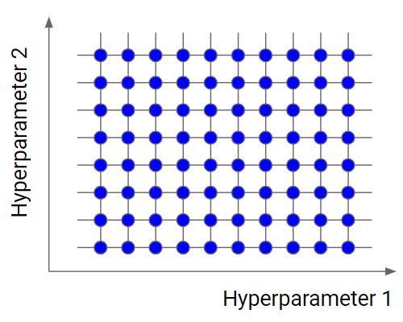
Grid search
Grid search is the simplest algorithm for hyperparameter tuning. Basically, we divide the domain of the hyperparameters into a discrete grid. Then, we try every combination of values of this grid, calculating some performance metrics using cross-validation

Slide 3
Grid search is an exhaustive algorithm that spans all the combinations, so it can actually find the best point in the domain. The great drawback is that it’s very slow. Checking every combination of the space requires a lot of time that, sometimes, is not available. Don’t forget that every point in the grid needs k-fold cross-validation, which requires k training steps. So, tuning the hyperparameters of a model in this way can be quite complex and expensive. However, if we look for the best combination of values of the hyperparameters, grid search is a very good idea.

Slide 4
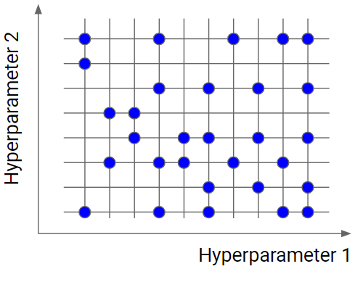
Random search
Random search is similar to grid search, but instead of using all the points in the grid, it tests only a randomly selected subset of these points. The smaller this subset, the faster but less accurate the optimization. The larger this dataset, the more accurate the optimization but the closer to a grid search.

Slide 5
Random search is a very useful option when you have several hyperparameters with a fine-grained grid of values. Using a subset made by 5-100 randomly selected points, we are able to get a reasonably good set of values of the hyperparameters. It will not likely be the best point, but it can still be a good set of values that gives us a good model.

Slide 6
Draw backs of grid search: One of the drawbacks of grid search is that when it comes to dimensionality, it suffers when evaluating the number of hyperparameters grows exponentially. However, there is no guarantee that the search will produce the perfect solution, as it usually finds one by aliasing around the right set.

Slide 7
